Slide 1
1.6.12 The roots of unity

Slide 2
Outline
In this topic, we will
Define the roots of unity
See how to find them

Slide 3
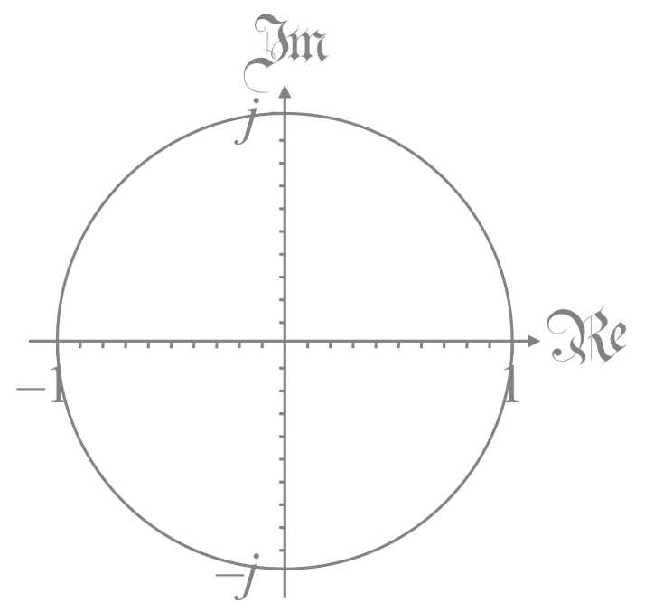
The 2nd roots of unity
The second roots of unity are all numbers which squared equal the value one
This includes z = 1 and z = –1
These are the roots of the polynomial z² – 1
There are exactly two roots

Slide 4
The 4th roots of unity
The fourth roots of unity are all numbers which raised to the power four equal the value one
This includes z = 1, j, –1 and –j
These are the roots of the polynomial z⁴ – 1
There are exactly four roots

Slide 5
The 3rd roots of unity
The third roots of unity are all numbers which cubed equal the value one
This includes z = 1 but what else?
These are the roots of the polynomial z³ – 1
There will be exactly three roots
In the polar representation, note that
Thus, or

Slide 6
The 3rd roots of unity
Let us plot these when

Slide 7
The 5th roots of unity
The fifth roots of unity are all numbers which raised to the power five equal the value one
These are the roots of the polynomial z⁵ – 1
There will be exactly five roots
In the polar representation, note that
Thus, or

Slide 8
The 5th roots of unity
Let us plot these when

Slide 9
The n^{th} roots of unity
The n^{th} roots of unity are all numbers which raised to the power n equal the value one
These are the roots of the polynomial z^{n} – 1
There will be exactly n roots
In the polar representation, note that
Thus, or

Slide 10
The n^{th} roots of unity
Thus, the roots will have the arguments

Slide 11
Application
The n^{th} roots of unity are used in the discrete Fourier transform
This involves going from time or space domains to frequencies

Slide 12
Summary
In this topic, you now
Understand the concept of the roots of unity
Have applied numerous ideas we have already discussed

Slide 13
References
[1] https://en.wikipedia.org/wiki/Root_of_unity

Slide 14
Acknowledgments
None so far.

Slide 15
Colophon
These slides were prepared using the Cambria typeface. Mathematical equations use Times New Roman, and source code is presented using Consolas. Mathematical equations are prepared in MathType by Design Science, Inc.
Examples may be formulated and checked using Maple by Maplesoft, Inc.
The photographs of flowers and a monarch butter appearing on the title slide and accenting the top of each other slide were taken at the Royal Botanical Gardens in October of 2017 by Douglas Wilhelm Harder. Please see
https://www.rbg.ca/
for more information.

Slide 16
Disclaimer
These slides are provided for the ne 11 Linear algebra for nanotechnology engineering course taught at the University of Waterloo. The material in it reflects the authors’ best judgment in light of the information available to them at the time of preparation. Any reliance on these course slides by any party for any other purpose are the responsibility of such parties. The authors accept no responsibility for damages, if any, suffered by any party as a result of decisions made or actions based on these course slides for any other purpose than that for which it was intended.

